Slide 1




Laser Frequency Stabilization
Rob Mullins , Dr. Andri Gretarsson & Elizabeth Gretarsson
Notes:
Firstly, we used a 1064 nm laser to go through a Faraday Isolator. This prevents any back scattering to go back into the laser using it’s heavy magnetic field. Next we fed the beam through a ½ wave plate in order to achieve the desired polarization. After we got the desired polarization we used a beam splitter to split the beam towards an Acosto-optic modulator (AOM). From here we chose the second order beam of the AOM to be reflected back into the beam splitter that well then go into the Elecrto-optic modulator (EOM).

Slide 2
Introduction
How does a feed back loop help stabilize a laser?
How does this help?
What can we do once I am done?
What does this look like?

Slide 3
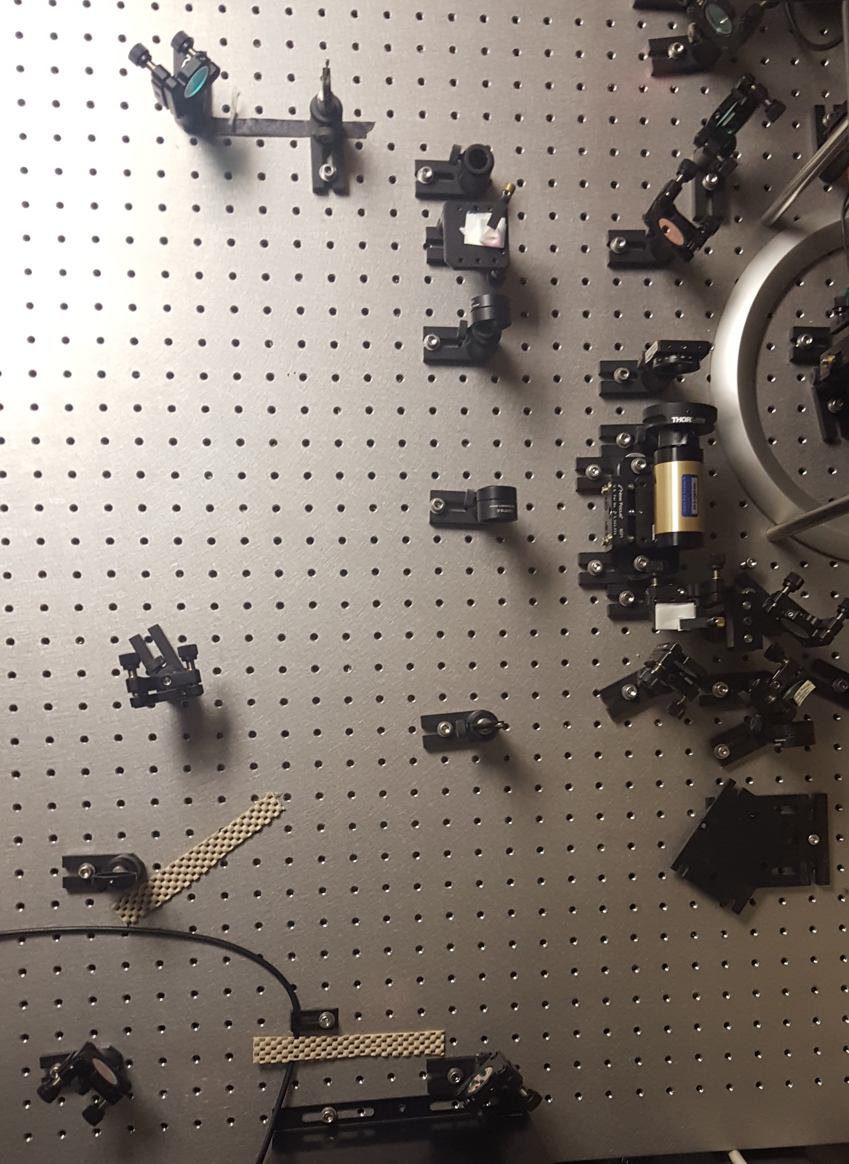
Initial Setup
EOM
AOM
Cavity
Notes:
Firstly, we used a 1064 nm laser to go through a Faraday Isolator. This prevents any back scattering to go back into the laser using it’s heavy magnetic field. Next we fed the beam through a ½ wave plate in order to achieve the desired polarization. After we got the desired polarization we used a beam splitter to split the beam towards an Acosto-optic modulator (AOM). From here we chose the second order beam of the AOM to be reflected back into the beam splitter that well then go into the Elecrto-optic modulator (EOM).

Slide 4
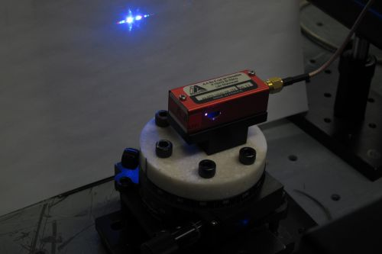
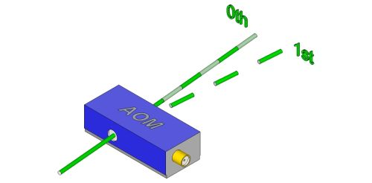
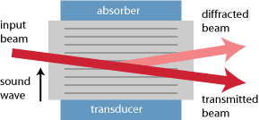

Acusto-Optic Modulator
Higher order modes described by:
$$Sin\left(θ\right)= \frac{m\text{λ}}{2n\text{Λ}}$$
Here is a diagram of a non-resonant AOM. [3]
Notes:
In general an AOM is used to Bragg Diffract a laser into higher orders, so that lower noise levels can be achieved. An AOM uses a piezoelectric transducer to create soundwaves in some medium to shift the frequency of light. In general and AOM can get upwards of 90% deflected into the next highest order.
In my lab I was able to get ~87.74% of the light into the second order. We used a asdfjksdajfkjasdfk amplifier to drive the AOM.

Slide 5
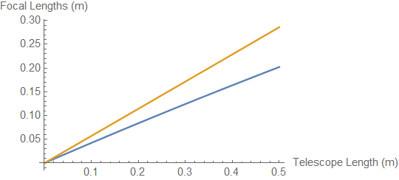
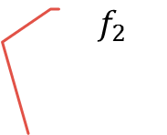


Lasing through the AOM
$$f_{1}$$
$$f_{2}$$
$$\frac{1}{f_{1,2}}=\frac{1}{R_{1,2}}+\frac{1+ \frac{w_{2,1}}{w_{1,2}}}{L}$$
Where,
$$w_{1}=\sqrt{ω_{°}^{2}+\frac{{\text{λ}}^{2}a^{2}}{π^{2}ω_{°}^{2}}}$$
$$w_{2}=\sqrt{ω_{°}^{2}+\frac{{\text{λ}}^{2}{(−b)}^{2}}{π^{2}ω_{°}^{2}}}$$
and ‘L’ is the length of the telescope, R is the radius of curvature of the lens, ‘a’ is the distance from the beam splitter to the first lens, ‘b’ is the distance from the second lens to the AOM, and ‘$ω_{°}$’ is the beams waist.
Length ‘L’
Length ‘a’
Length ‘b’
Notes:
Getting the laser into the AOM requires us to create a ‘telescope’ in order to move the waist into the desired position. A telescope is a set of lenses that adjusts the beams profile to match a desired waist and radius of curvature. This is the general process :

Slide 6
Future Goals and Plans
Lase through the Electro – Optic Modulator to create side bands.
Lock The Cavity to the TEM00 Mode.
Create a feedback signal from the cavity to the laser.
Use new laser to model cavity dynamical systems.
Notes:
This project has recently gotten me interested in Cavity Dynamics. I will soon start to model how scattering from outside materials effect cavities. I will model a cavity with a adklfadjfjsf placed on a mirror as well as simulating a adasdfasfdasf falling through a cavity and passing through the beam.

Slide 7
Acknowledgements
Big thanks to the NASA Space Grant for allowing me to further my research, as well as the help from:
Dr. Andri Gretarsson
Elizabeth Gretarsson
Marina Koepke
Embry Riddle Aeronautical University

Slide 8
References
[1] Eric D Black, “An introduction to Pound-Drever-Hall laser frequency stabilization”, American Journal of Physics 69, 79, Jan. 2001.
[2] Marina Koepke ,“Pound-Drever-Hall Laser Stabilization” ,Embry Riddle Aeronautical University
Nov. 6 2015
[3] Paschotta, Dr. Rüdiger. "Acousto-optic Modulators." Encyclopedia of Laser Physics and Technology - Acousto-optic Modulators, AOM, Bragg Cells. N.p., 20 Feb. 2017. Web. 07 Apr. 2017.
Bennett, Charles Aycock. Principles of Physical Optics. Hoboken (N.J.): Wiley, 2008. Print.

Slide 9
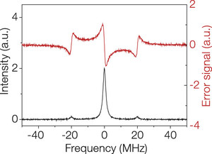
Pond-drever-hall
The Pound-Drever-Hall method is a technique used to improve the stability of the laser. The general idea behind this method is simple. A laser is fed into a Fabry-Perot cavity where it is measured and then fed back into the laser to suppress the frequency fluctuations.

Slide 10
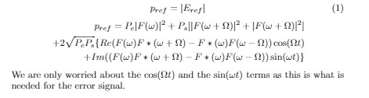

The cavity
In order to properly propagate the laser into the cavity we must ‘mode match’ the laser into the cavity. This means adjust the characteristic profile of the laser to match what it should look like while in the laser. This is generally done using the telescoping method. Once this is done we can start to get side bands by using a function generator to forcibly drive the piezoelectric plate on the end of the cavity mirror forcing the cavity to run through different modes.
The cavity will produce a laser along with a reflected beam and side bands. These side bands and reflected beam will send a beat frequency to the photodiode where the power of the signal is measured.[Once the side bands are achieved we can control the length of the cavity in order to create the TEM00 mode from resonance. [2]
By mixing the signal with an oscillator we will obtain an error signal where $V∝∆L$.

